Slide 1
My careers
By jallysa

Slide 2
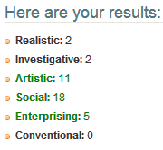
My survey results
I did the testing of personal types to see what it describe me at and it said I'm very accurate.
I did a interest profile to see what I am and it said that I'm good at social.
The social said that I am good at working teaching and hands on

Slide 3
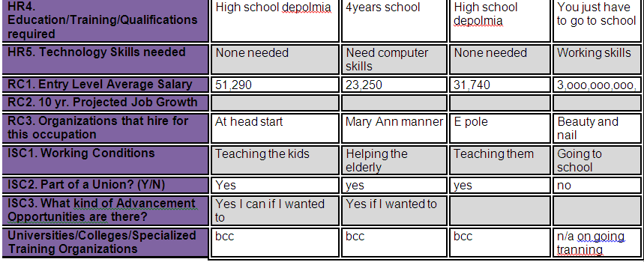
Why I took this survey
When I took the survey I realize that it would give me some tips on how to get into medical and hands on and all the above I cant see see my self doing all this on my own once I learned about medical I wanted to do it I think I'm capable of working hands on .

Slide 4
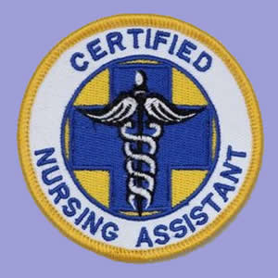
Why I chose this career
I chose this career because I wanted to see what I can find .I wanted to go to college for cna and I'm glad I found the information I need to be prepared for it. I always wanted to be a cna since I was in my teens.

Slide 5

Planning for the future
The past couple of weeks I been going to different collages and I signed up for 5 to see what one I would like best and they have medical hands on .

Slide 6
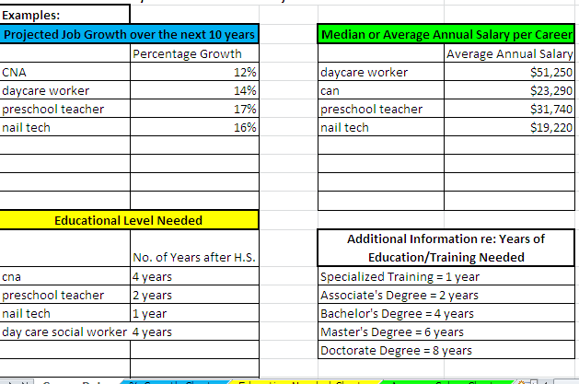
The next 10 years

Slide 7
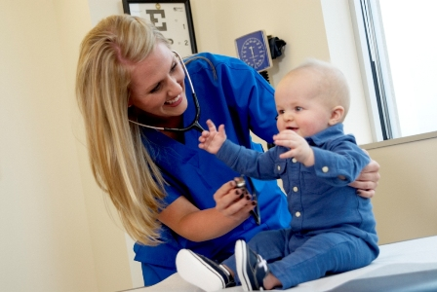
My favorite things are
CNA hands on and a daycare social worker for little kids so I can help them out with there problems.

Slide 8

What I like about cna
conclusion 1
What I like about CNA is that its hands on I like the fact that I got to research it because it helped me learn more. I wanted to see if I would be more interest in CNA because I always wanted to be a CNA it pays more but its more hands on then anything else.

Slide 9

The reason why I picked a daycare social worker
conclusion 2
The reason why I picked day care social worker is because I want to help the kids that are having trouble at home or school.

Slide 10
Career as a cna
The reason why I choose CNA because I think being a CNA is easier then dealing with little kids.
I always wanted to go to college to become a CNA when I finish school I'm going to hopefully go to BCC because they have hands-on training and its step by step.

Slide 11
Career as a preschool helper
The reason why I picked preschool helper is because I love helping people and kids if they are having a hard time I always took care of little ones.
I think if I have and option of CNA and working with little kids I would pick CNA because its less stress.

Slide 12
Why I am choosing to be a cna
little kids are more stressful then elderly people because you have to give them more attention and you have to be more aware what goes on and you have to make appointments to see the kids at home and you would have to do meeting and give them nap time and etc..
when cna you can leave them alone for a couple of hours and they are easier to deal with u wont get a lot of stress all you got to do is make sure they are clean feed changed make sure they go to there appointments make sure they go to group put them to bed .

